Slide 1

A Data-Driven Strategy for
Gardein’s Products and Regional Growth

Slide 2
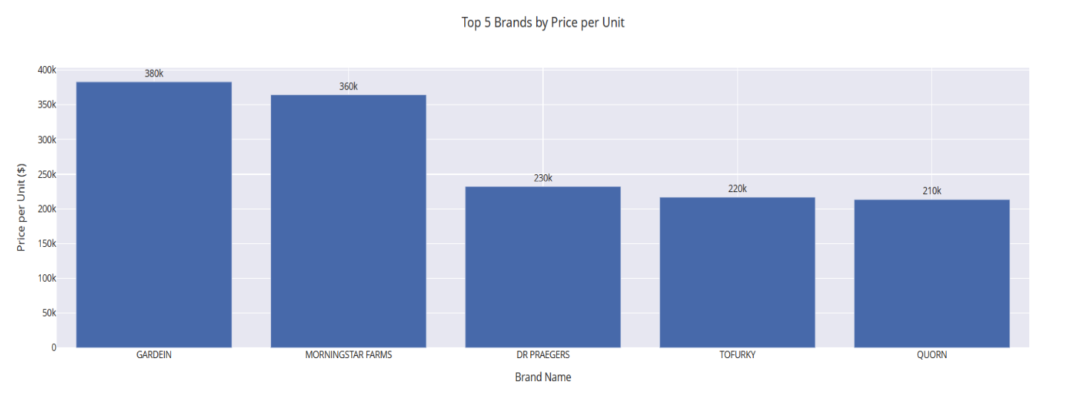
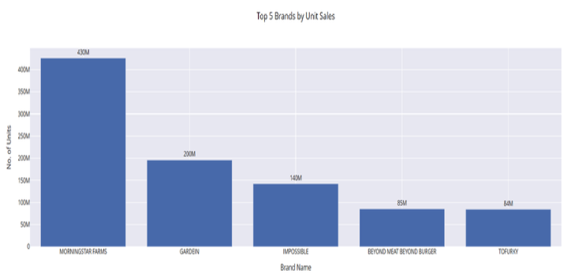
Exploratory Data Analysis

Slide 3
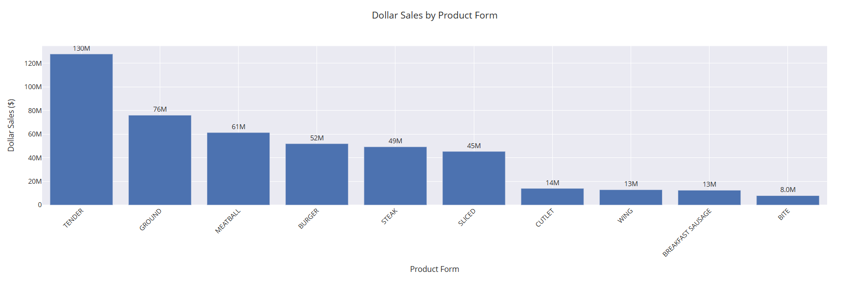
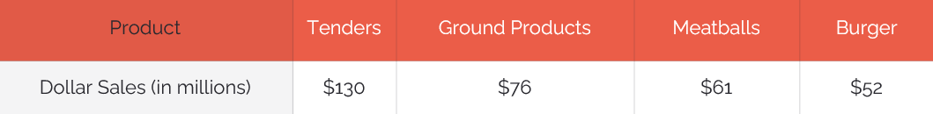
Top Performing Products
Product
Dollar Sales (in millions)
Tenders
$130
Ground Products
$76
Meatballs
$61

Slide 4
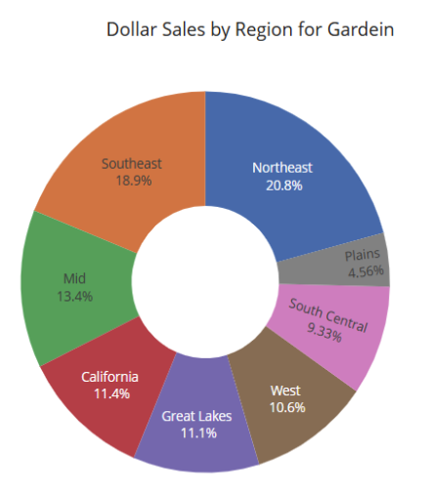

Slide 5

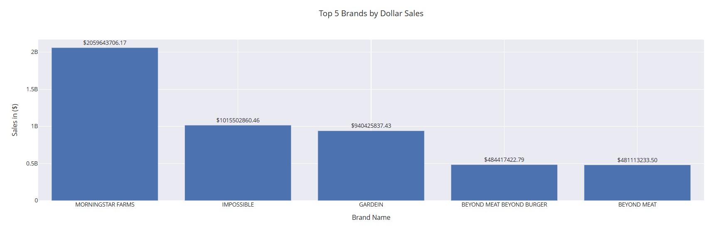
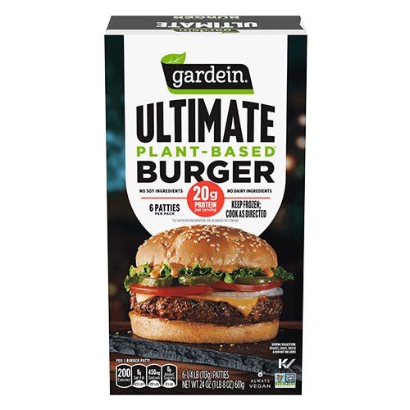
Comparison to Industry Leader

Slide 6
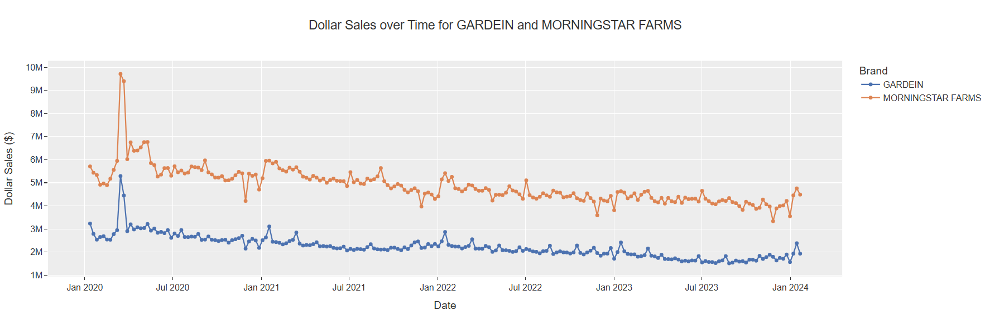

Slide 7



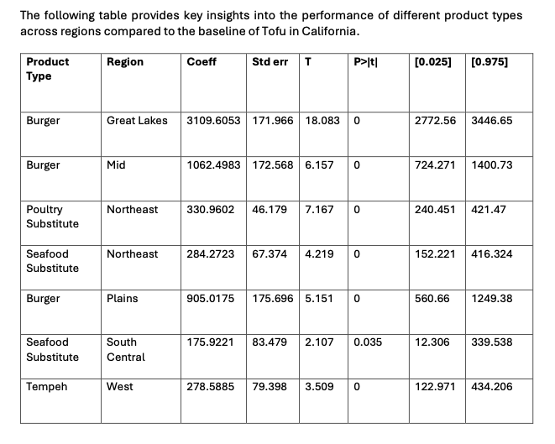
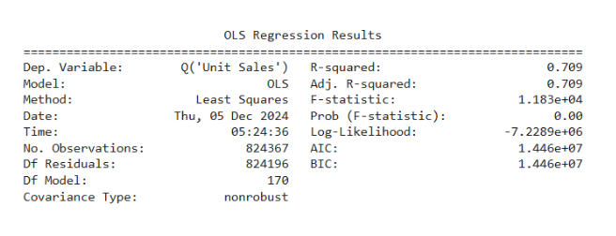
Regression Analysis Insights
Burgers: The Dominant Product
Poultry and Seafood Substitutes in the Northeast
Tempeh and Seafood Substitutes in the West and South Central

Slide 8
Recommendations to Boost Gardein's Unit Sales
Prioritize Burgers & Falafel
Reposition Seafood & Plant-Based Meat Substitutes
Reassess Seitan & Soy Substitutes
Invest in production, regional flavors, and targeted promotions.
Address awareness and appeal issues or consider discontinuation.
Highlight health and sustainability benefits, offer trial sizes.
Expand in High-Performing Regions
Tackle Challenges in South Central
Localized Campaigns
Collaborate with regional influencers and emphasize eco-friendly benefits.
Focus on Great Lakes, Northeast, and Southeast with increased marketing and retailer collaboration.
Tailor products and messaging to local tastes.

Slide 9

Thank You
Notes:
.

